Slide 1


Slide 2


Slide 3
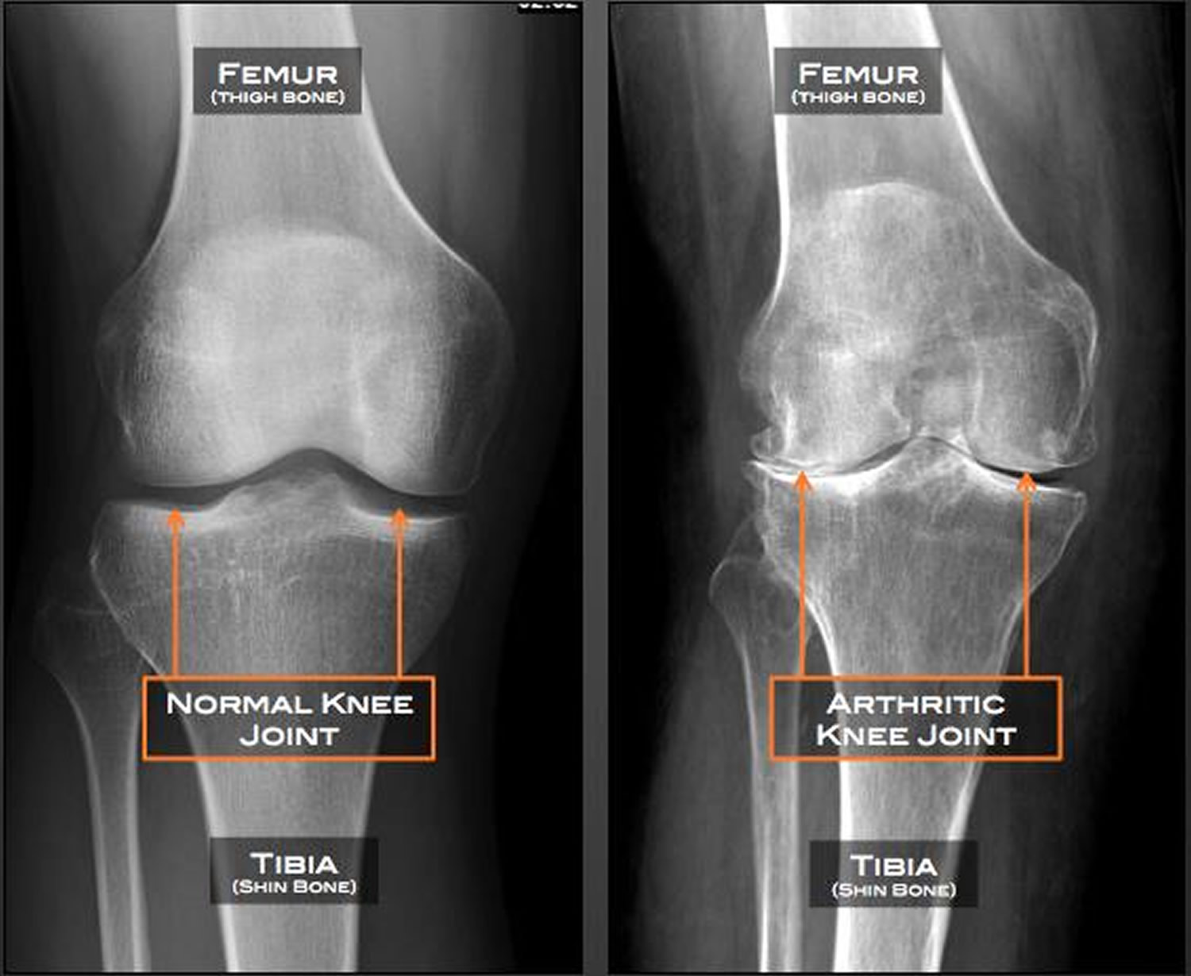

Slide 4
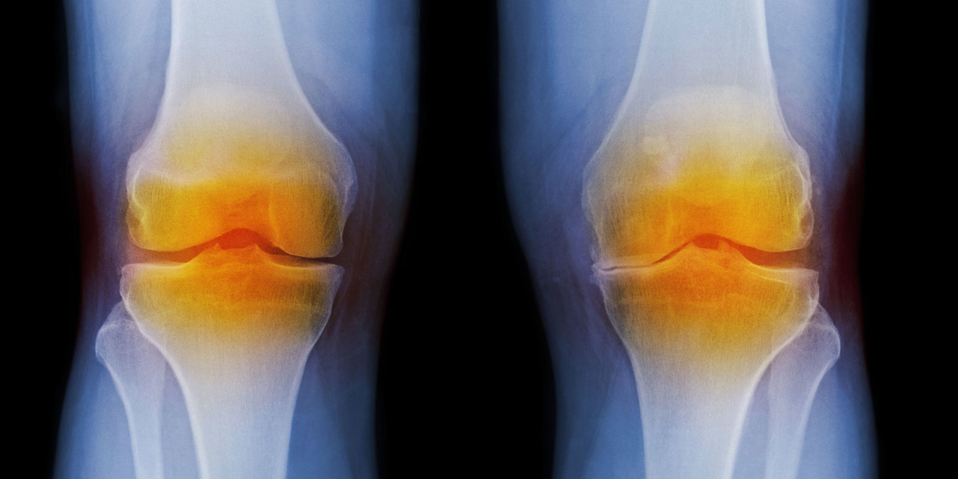
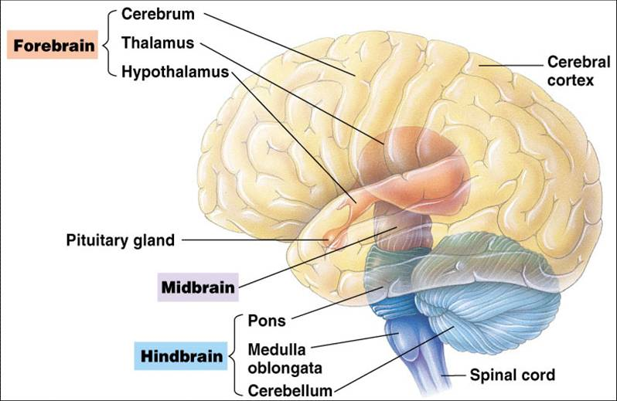
Osteoarthritis and age related changes in central nervous system
Prepared by:
Bandana Tiwari
Roll no:6
BNS 2nd year

Slide 5
General Objective
At the end of the classroom session, BNS 1st year students will be able to explain about osteoarthritis and age related physiological changes in central nervous system .

Slide 6
Specific Objectives
At the end of this teaching session, the BNS 1st year students will be able to :
define osteoarthritis
state the classification of osteoarthritis
list the causes of osteoarthritis
explain the pathophysiology of osteoarthritis
state the signs and symptoms of osteoarthritis

Slide 7
enlist the diagnostic investigation of osteoarthritis
explain the treatment procedure of osteoarthritis
explain the nursing management of osteoarthritis
list the complication of osteoarthritis
explain the prevention of osteoarthritis
state the age related changes in central nervous system.

Slide 8

Osteoarthritis

Slide 9
Osteoarthritis
Osteoarthritis (OA) is a slow progressing joint inflammation that can result from cartilage degeneration , joint hypertrophy.
It is also known as degenerative joint disease or wear – and – tear arthritis .
Osteoarthritis is an inflammatory of joint cartilage as a chronic progressive process in which new tissue produced in response to joint damage and cartilage deterioration .

Slide 10
It shows a strong association with aging and is a major cause of pain and disability in the elderly.
Osteoarthritis commonly affects the hands, feet, spine , and large weight bearing joints such as hips and knees.
Osteoarthritis is one of the common causes of disability due to limitations of joint movement , particularly in people over the age of 50.
Osteoarthritis rarely starts before 40, but by the age of 80 affects 80% of the population.

Slide 11
Classification :
It has been classified as:
Primary osteoarthritis :
(Idiopathic ) Primary osteoarthritis occur in accordance to age , heredity and activity- related deterioration on joint cartilage , resulting in a total loss of cartilage cushion between the bones of joints .

Slide 12
2) Secondary osteoarthritis :
It is resulting from previous joints injury or inflammatory disease; or some underlying disease such as diabetes, trauma or marked obesity.

Slide 13
Risk factors
Age
Gender
Hereditary
Obesity
Bone infection

Slide 14
Joint injury
Diabetes mellitus
Nutrition deficiency : vitamin D and calcium
Repetitive or excessive use of stress on joint

Slide 15
Osteoarthritis
Mechanical injury
Genetic and hormonal factors
Previous joint damage
Others
Chondrocytes Response
Release of cytokines
Stimulation, production and release of proteolytic enzymes,
metalloprotease, collagenase
Resulting damage predisposes to further damage
Fig: Pathophysiology of osteoarthritis

Slide 16
Signs and symptoms
Stiffness in a joint
Swelling
Pain
Functional impairment
Redness , warmth skin

Slide 17
Cont..
Hip pain may be followed by limp or loss of motion
Crunching feeling

Slide 18
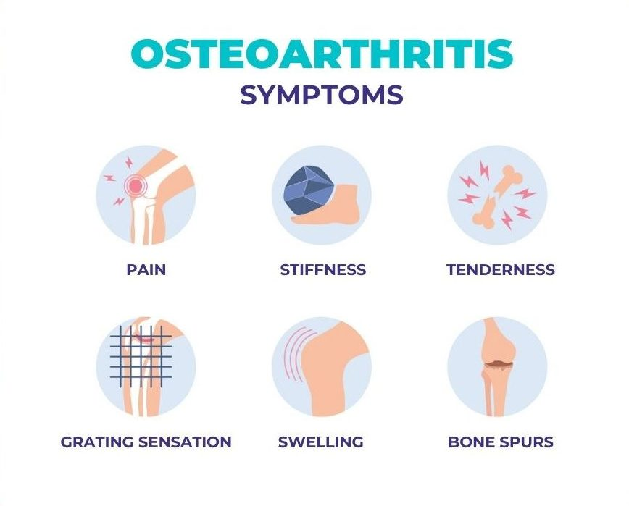

Slide 19
Diagnostic Investigation
History taking
Physical examination
X-Ray report 30-40% confirmed
MRI (Magnetic Resonance Imaging)
Synovial fluid test to rule out infection or crystal deposition

Slide 20
Cont..
Laboratory Tests:( ESR(Erythrocyte sedimentation rate), CRP(C-reactive protein ), CBC(Complete blood count)
-Uric Acid etc
Computed Tomography Scan (CT scan )

Slide 21
Management
Goals of treatment :
Control of pain
Improve joint function
Restore lifestyle
Maintain normal weight

Slide 22
Conservative Treatment :
Use of heat
Weight reduction
Joint rest
Orthotic device to support the inflamed joints ( splint , braces )
Isometric , postural exercise and aerobic exercise

Slide 23
Cont..
Physical modalities such as massage , yoga and TENS ( Transcutaneous electrical nerve stimulations).

Slide 24
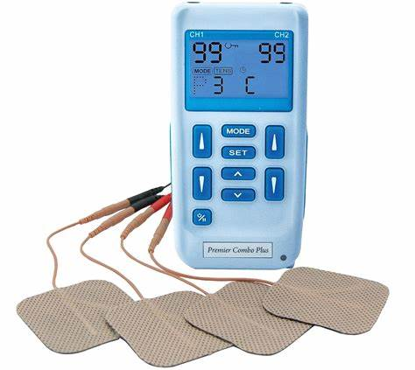
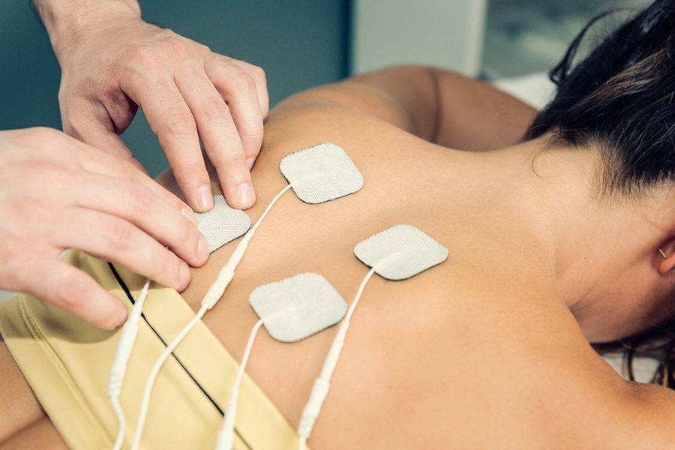
Transcutaneous electrical nerve stimulation

Slide 25
Pharmacological Therapy
Analgesics
Anti- inflammatory drugs
Cox-2 enzyme blockers e.g. celecoxib ( for patients with increased risk for GI bleeding)
Antibiotics
Immunosuppressant

Slide 26
Physical Therapy :
Encouraged for exercise as a way of keeping joints cartilage lubricated and mobile.
Occupational Therapy:
Can help patient to do everyday tasks without putting extra stress on affected joint.

Slide 27
Supportive Therapy:
Nutritional supplementation e.g. vitamin A, B, C,B6, calcium and magnesium , use of assertive devices e.g. walking frame.

Slide 28
Surgical Management
Surgical intervention is considered when the pain becomes intolerable to patient and mobility is severely compromised.
Cortisone injection
Osteotomy
Debridement
Joint replacement
Arthroscopy and arthroplasty

Slide 29
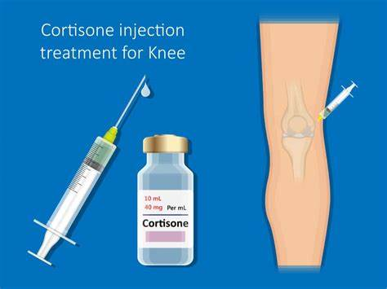
Cortisone injection

Slide 30
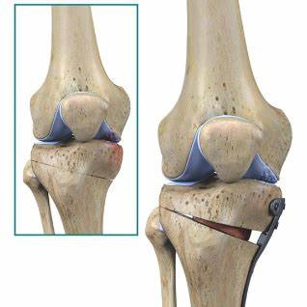
Osteotomy

Slide 31
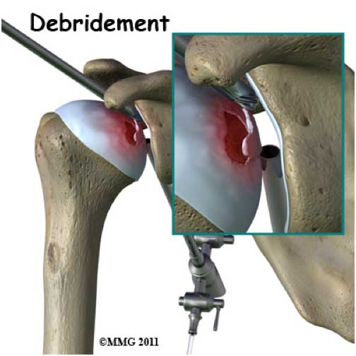
Debridement

Slide 32
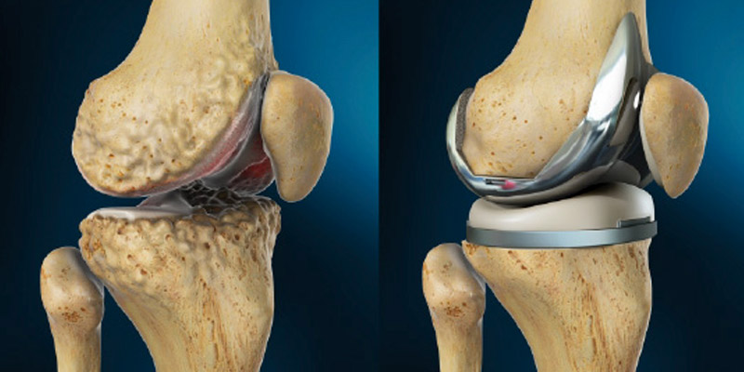
Joint replacement

Slide 33
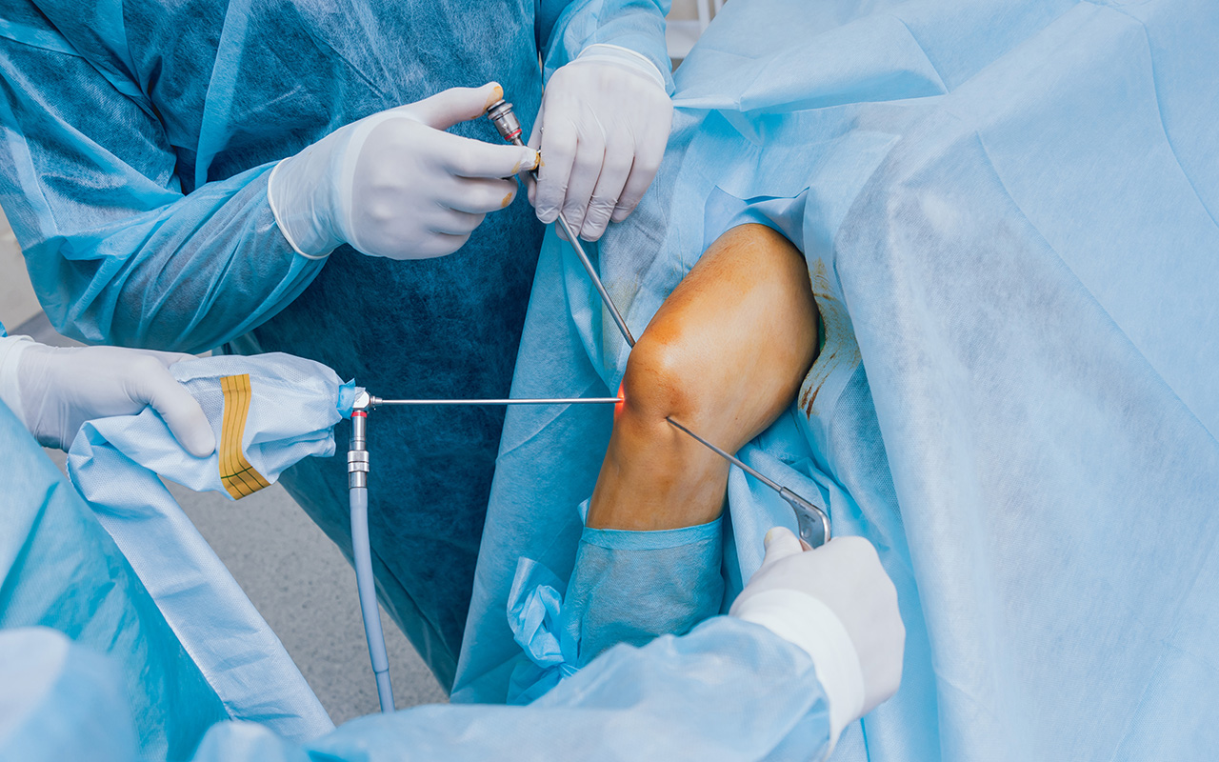
Arthroscopy

Slide 34
Nursing management
Nursing Assessment
Obtain history of pain and its characteristic, including specific joint involved.
Evaluate range of motion (ROM) and strength.
Assess effect on activities of daily life and emotional status.
Assess for skin irritation .

Slide 35
Nursing Diagnosis
Acute or chronic pain related to joint degeneration and muscle spasm.
Impaired physical mobility related to pain and limited joint motion.
Self -care deficits related to pain and limited joint motion.
Sleeping pattern disturbance related to emotional stress.

Slide 36
Nursing Intervention
Relieving pain :
Advice patient to take prescribed NSAID or analgesics as directed to relieve inflammation and pain . May alternative with opioid analgesics, if prescribed .
Provide rest for joints .

Slide 37
Teach correct posture and body mechanism- postural alterations lead to chronic muscle tension and pain.
Advice patient to avoid activities that precipitate pain.
Apply heat as prescribed – relives muscle spasm and stiffness.
Provide crutches, braces or cane when indicated – to reduce weight bearing stress on hip and knees.

Slide 38
Advise to wear corrective shoes and metatarsal supports for foot disorders also helps in the treatment of arthritis of the knee.
Encourage for weight loss to decrease stress on weight- bearing joints.

Slide 39
Increasing physical mobility
Encourage activity as much as possible without causing pain.
Teach range of motion (ROM) exercises to maintain joint mobility and muscle tone for joint support , to prevent capsular and tendon tightening , and to prevent deformities.
Teach isometric exercise to improve muscle strength around the involved joint.

Slide 40
Promoting self- care
Suggest performing important activities in morning, after stiffness has been abated and before fatigue and pain become a problem.
Advise on modifications, such as wearing looser clothing without buttons, placing bench tub or shower for bathing, sitting at table or counter in kitchen to prepare meals.
Help without obtaining assistive devices, such as padded handles for utensils and grooming aids, to promote independence.

Slide 41
Promoting sleep
Encourage to express their feeling .
Provide comfortable bed .
Avoid unnecessary sound .
Advise sleeping with a rolled terry cloth towel under the neck for relief of cervical osteoarthritis.

Slide 42
Complication
Infection to the joint
Bone death
Stress fracture
Bleeding inside the joint
Pinched nerve ( in osteoarthritis of the spine)

Slide 43
Prevention
Maintain ideal body image .
Exercise regularly and participate in regular physical activity.
Protect the joints
Avoid repetitive stress on the joint
Avoid injury to joints

Slide 44
Physiological changes in central Nervous system
The structure and function of the nervous system changes with advance age.
Nerve impulses are conducted more slowly.
Neurological changes can affect gait and balance.
Mental function is threatened by physical and emotional stresses.

Slide 45
Number of dendrites also decrease.
The autonomic nervous system perform less efficiently, postural hypotension .
The slowed reaction time puts older people at risk for falls and injuries.

Slide 46


Slide 47


Slide 48
POST TEST
True or false(1*1)= 1
Secondary osteoarthritis is caused by heredity
(False)
Osteoarthritis can cause stress fracture
(True)
Fill in the blanks (1*1)= 1
During the process of aging the number of dendrites ……
Increase
Decrease

Slide 49
Assignment
What is osteoarthritis ? List the type of osteoarthritis . Write the nursing management of osteoarthritis.
Write the physiological changes in central nervous system.

Slide 50
Plan for next class
We will discuss about common neurological problems of older adults in next class.

Slide 51
References
Baral , R. Essential of Geriatric Nursing. Makalu publication.
Bruners and Siddharth, Medical Surgical Nursing, 10th edition.
Pradhan , M,K and Roka, A,T. (2015). Gerontological Nursing for BN/BSN Students (1st edition) Vidyarthi Prakashan
Subedi, P,S and Subba, K,H.(2019). A Textbook of Geriatric Nursing.(1st edition ). National Book Center.

Slide 52
Timalsina, R. (2077). Comprehensive Textbook of Geriatric Nursing.(3rd ed). Samiksha publication.
https://www.webmd.com

